Slide 1
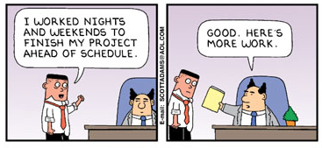
Impact of Overtime hours on Attrition
MSBA 6440 – Data Driven Experimentation
Abhinav | Kavya | Pranav | Rutwik | Raghuveer

Slide 2

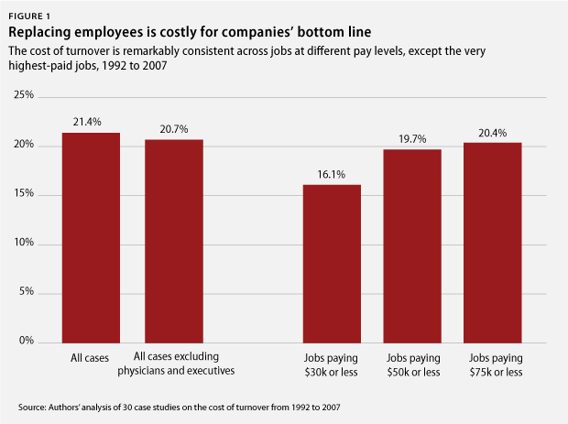


Why do we care about overtime and attrition?
“Employee turnover is expensive. Replacing an employee who quits costs, on average, 21% of their annual pay.”
- There Are Significant Business Costs to Replacing Employees, 2012
“Long hours and heavy work loads are fueling turnover ... burnout was driving up to 50% of annual turnover”
- Feeling Burned Out at Work?, 2017
“.. Highest voluntary attrition across sectors was seen in the IT services sector at 21.9%”
- IBM article, 2017

Slide 3




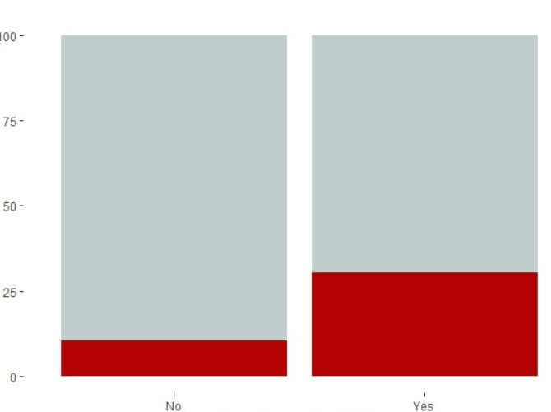










We use the IBM HR dataset to study the impact of overtime on attrition
HR dataset is a cross-sectional dataset containing employee, work-life and job related data
We see that people who worked overtime have a higher attrition rate
Did not quit
People who quit
Attrition (%)
Overtime
Did not over-work
Worked overtime
Attrition

Slide 4
Based on this dataset, we see that working overtime increases probability of leaving by 18.2%
18.2%
Probability of Attrition

Slide 5



We cannot randomly make employees work overtime and overtime status may depend on other factors
What would we ideally do?
In real world, randomization does not work the same way, and these groups might not be similar
Yes
No
Male
Female
Do they leave more often then others?
Possible that men work overtime than women
Higher
Lower

Slide 6
Employees working overtime differ in gender, satisfaction and training distribution

Slide 7




… and hence we have to match attributes from the groups to find out the impact of only over-time status on attrition
We use propensity score matching to pseudo-randomize groups such that the only difference between them is that they worked overtime
The only thing different between these groups was that they worked overtime or not

Slide 8
Once we randomize, we now have even groups with only difference being one group worked overtime

Slide 9
We found that employees that work overtime have 18.2% higher chance of leaving as compared to employees who do not
Single people are more likely to leave the firm when overtime
18.2%
Probability of Attrition

Slide 10
We found that employees that work overtime have 20% higher chance of leaving as compared to employees who do not
Stock options are an effective strategy to check employ attrition even when working overtime
Employees more acceptable to working over time in their mid –level career growth time

Slide 11




We take multiple assumptions while doing this experiment
Interference
Temporal Precedence
No endogeneity
Let’s Quit?
Sure!
Employee interactions can lead to over-worked employees influencing others
Since, employee’s who quit can no longer work, we can always assume X before Y
Sample is representative of population
No measurement error
All drivers are taken into consideration

Slide 12
There are many limitations with our approach and we plan to improve by using more data
There are multiple factors that are not observed in the dataset, that might have an impact on both working overtime and decision to leave
We lost records during the matching process thus reducing the statistical power of the analyses

